Slide 1

Ori Barel
Pressure wound
Segmentation -Reuth Medical Center

Slide 2
Throughout this project, we develop a clinical decision-support pipeline by combining deep learning for wound image analysis with structured data modeling, aiming to enable automated and clinically meaningful wound assessment at Reuth Medical Center.
Project Overview

Slide 3
Image De-identification - to ensure full patient privacy
Automatic Mask Generation - using a segmentation algorithm trained on manual labels
Automated Wound Analysis from Images - linking medical records with corresponding wound images
Application Deployment - for use within Reuth Medical Center
Methodology

Slide 4
To automatically detect and blur sensitive patient information, we developed an image-segmentation model based on a UNet architecture - a widely used convolutional neural network designed for precise pixel-level predictions.
Image De-identification

Slide 5
Encoder-decoder structure for capturing both global context and fine details
Skip connections that preserve spatial information for accurate mask reconstruction
Custom loss combining BCEWithLogits (with positive class weighting) and Dice Loss to address class imbalance and improve overlap accuracy
Evaluation using IoU and Dice score for segmentation quality assessment
Data augmentation including flips, rotations, and color jitter to improve robustness
The Unet model
This network learns from manually created de-identification masks and can automatically locate and mask identifying text or markers on new wound images. The algorithm was intentionally designed to operate conservatively, ensuring minimal risk of information leakage.

Slide 6
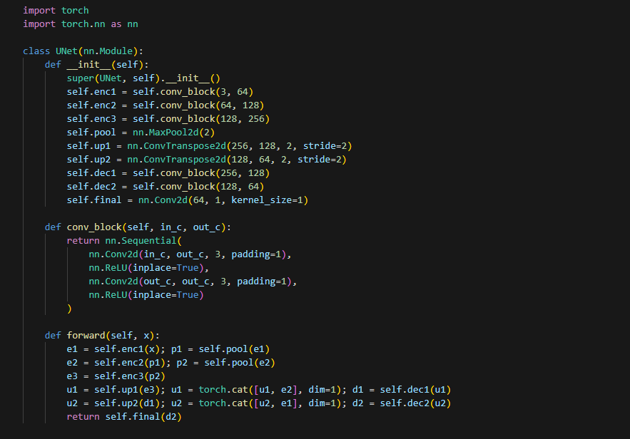
The Unet model - Structure

Slide 7
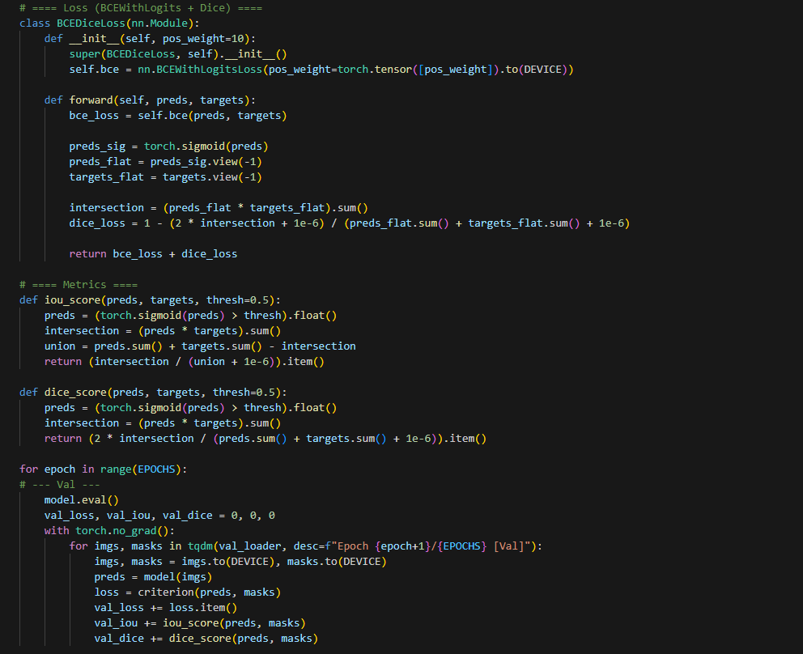
The Unet model - Loss function + Metrics

Slide 8
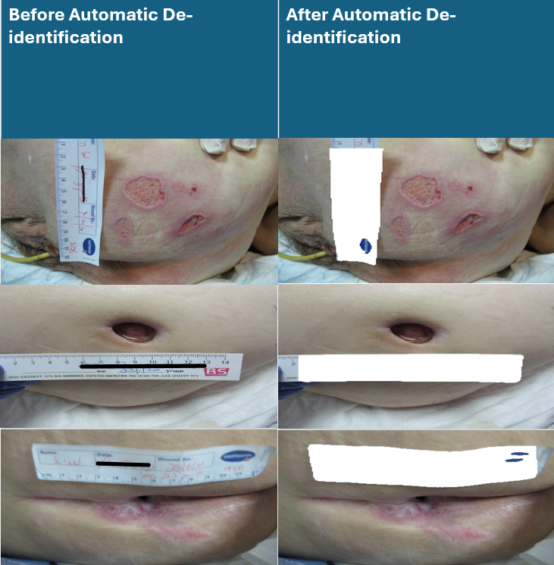
The Unet model - Example

Slide 9
Results
Metric | Train | Validation
LOSS | 1.9238 | 1.9819
IoU | 0.0837 | 0.0974
Dice | 0.1583 | 0.1733

Slide 10
To generate highly reliable wound segmentation masks, we trained and evaluated an FPN with a ResNet-50 backbone - a multi-scale segmentation architecture enhanced with channel-wise attention and dropout regularization for improved robustness.
Automatic Mask Generation

Slide 11
ResNet-50 feature extractor pretrained on ImageNet
FPN multi-scale decoder capturing both coarse and fine-grained wound structures
Enhanced with lightweight channel-wise attention and dropout regularization to improve robustness and stability
Trained using a consistent custom loss for fair cross-model comparison (Focal Tversky, Weighted BCE, Color Contrast)
FPN + ResNet50 Backbone

Slide 12
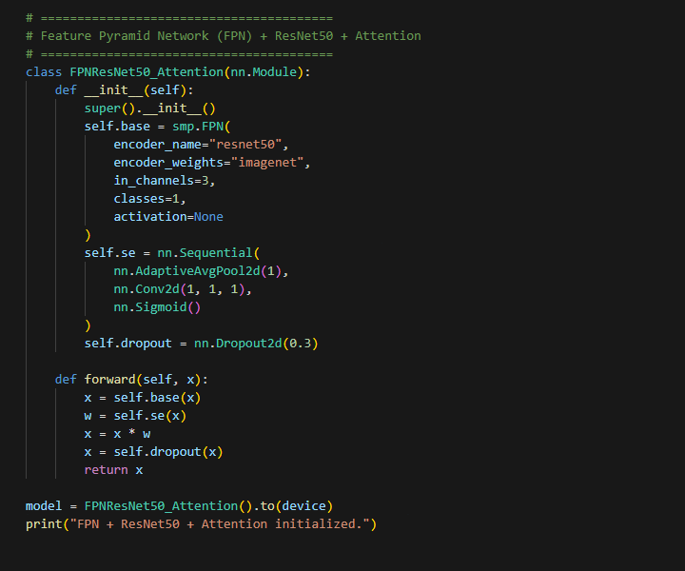
FPN + ResNet50 Backbone - Structure

Slide 13
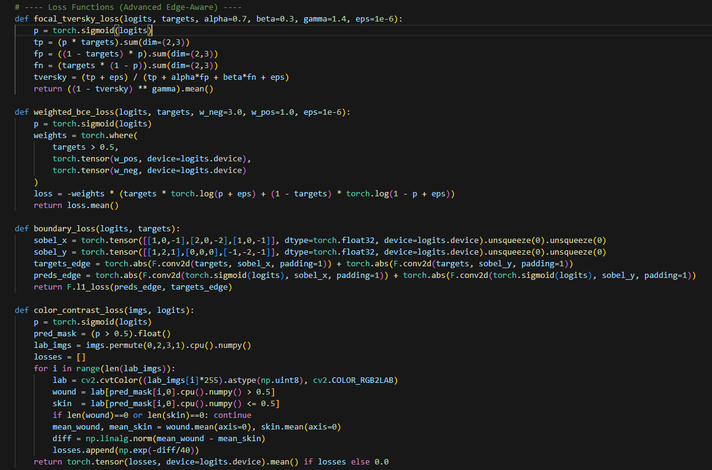
FPN + ResNet50 Backbone Loss functions + Metrics

Slide 14
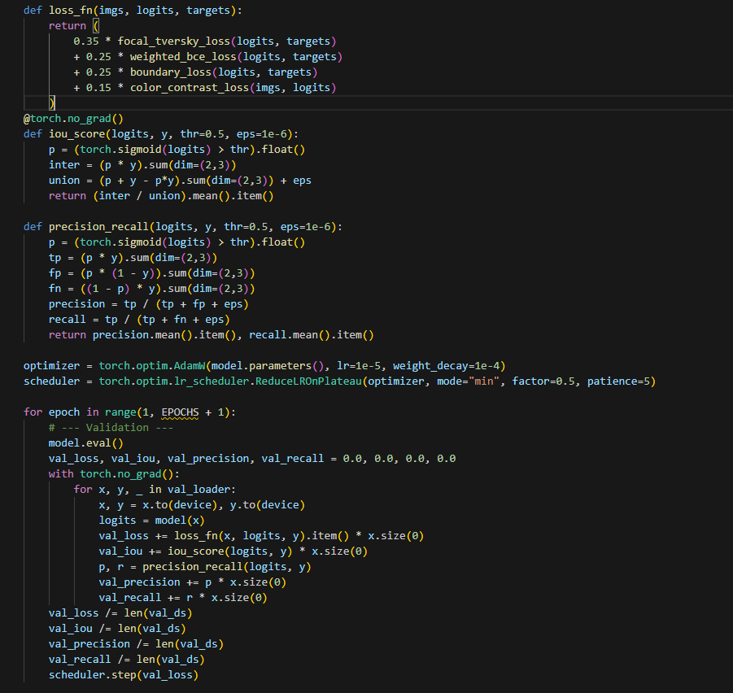
FPN + ResNet50 - Backbone Loss functions + Metrics

Slide 15
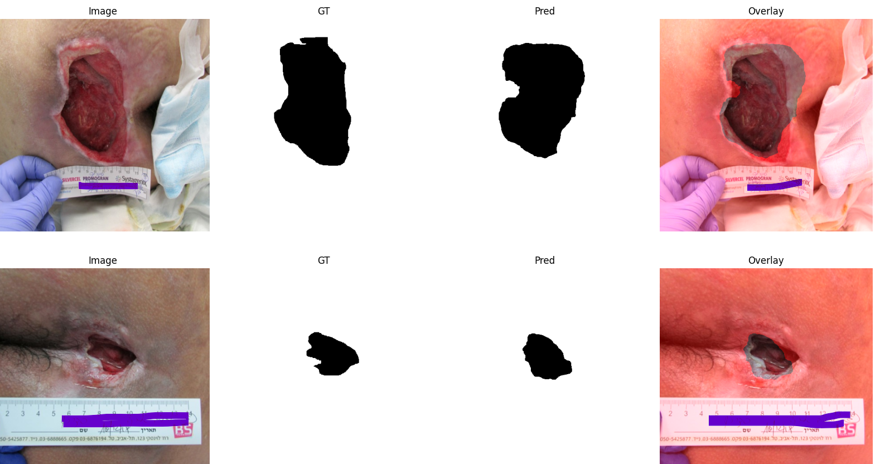
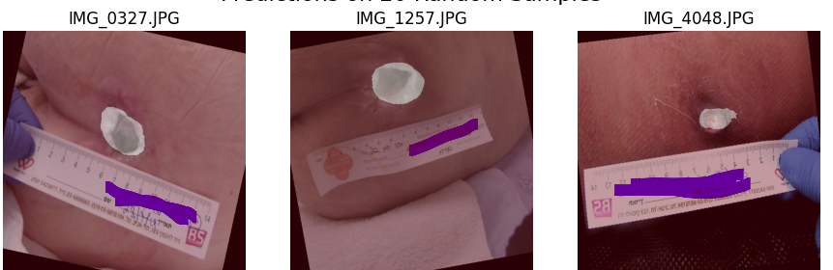
FPN + ResNet50 Backbone

Slide 16
Model Performance Summary
Model | Epochs | Train Loss | Val Loss | IoU | Precision | Recall
FPN + ResNet50 | 25 | 0.2785 | 0.2376 | 0.4169 | 0.7869 | 0.8459

Slide 17
We develop a deep learning pipeline for automatic wound assessment from clinical images. The system combines segmentation-based localization with multi-task classification to extract key clinical attributes such as exudate type, exudate amount, tissue color, and wound grade.
Automated Wound Analysis from Images

Slide 18
• Wound images → segmentation → focused ROI • ResNet-18 feature extraction • Multi-task prediction (exudate, amount, color, grade) • Handles class imbalance (weighted loss) • Goal: automated wound assessment
Automated Wound Analysis from Images

Slide 19
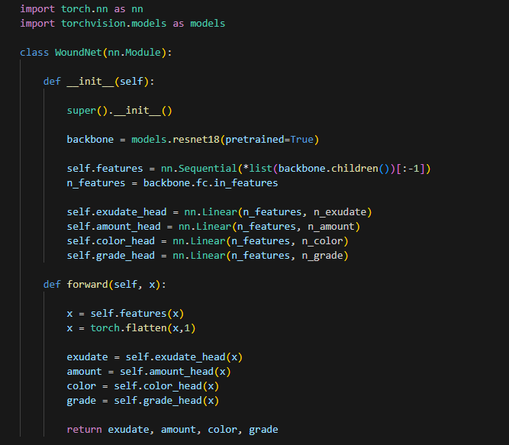
Automated Wound Analysis from Images - Structure

Slide 20
TBD
Automated Wound Analysis from Images - Results

Slide 21
TBD
Application Deployment

